Slide 1
internship
Mentorness
Task-3 Batch Name: MIP-ML-16
Predicting Customer Purchase Behavior
By: Gautam Kumar maurya
Notes:
NOTE:
To change the image on this slide, select the picture and delete it. Then click the Pictures icon in the placeholder to insert your own image.

Slide 2
(Categorical Problem) Logistic Regression Model
To build the model I performed 4 steps.
1. Data loading and Preprocessing
2. Finding Correlation and Visualization
3. Feature Engineering and Split the data
4. Train and Test The data

Slide 3
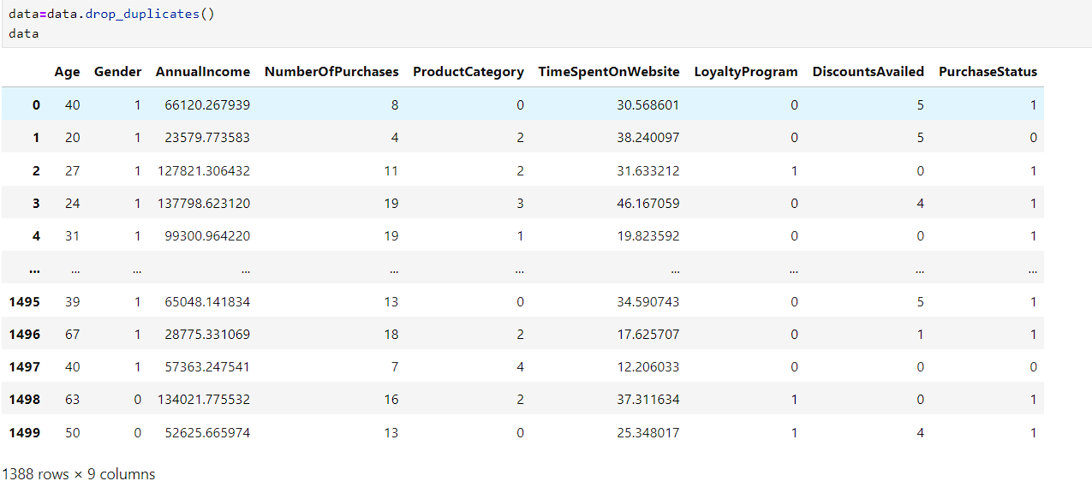
Step - 1
Data loading and Preprocessing
Read data set using pandas read_csv fumtion
1.The data has 1500 entry
2.The given data has no null values
3.The data has 112 duplicate rows

Slide 4
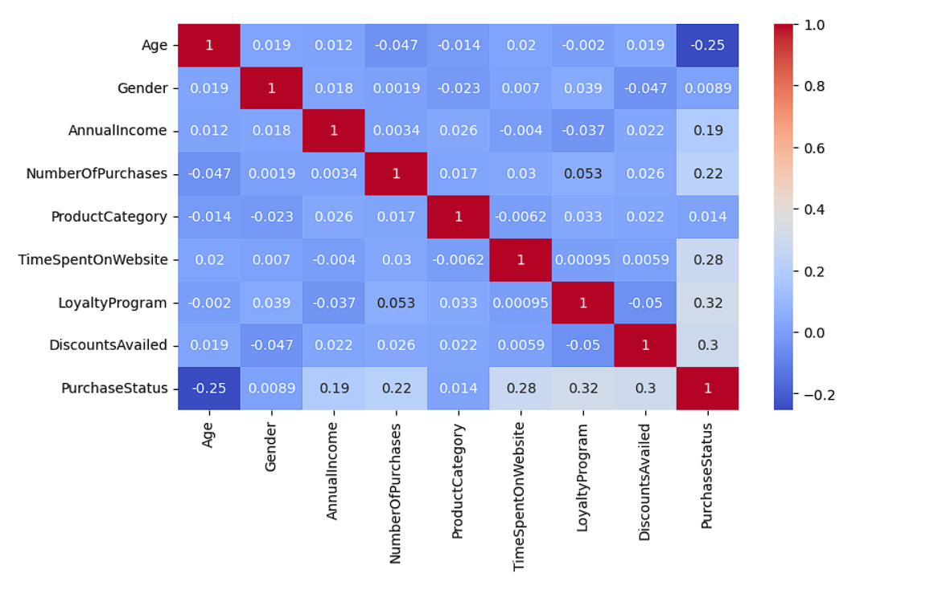
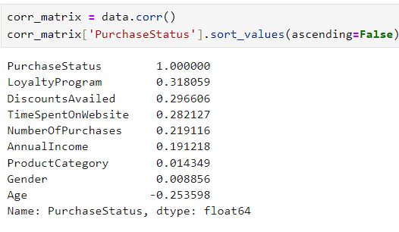
Step – 2 Finding Correlation and Visualization
Columns :
['Age', 'Gender', 'AnnualIncome', 'NumberOfPurchases', 'ProductCategory', 'TimeSpentOnWebsite', 'LoyaltyProgram', 'DiscountsAvailed', 'PurchaseStatus']

Slide 5
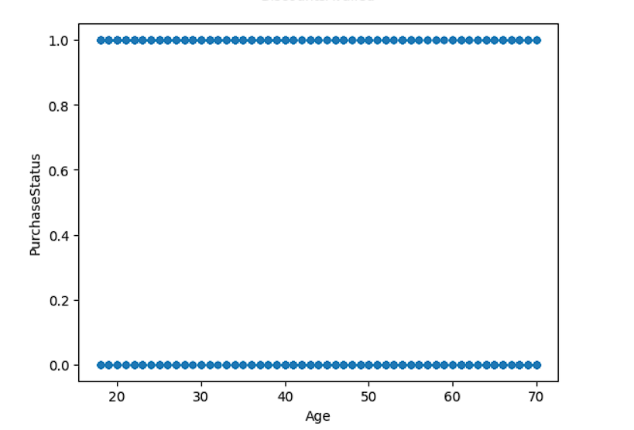
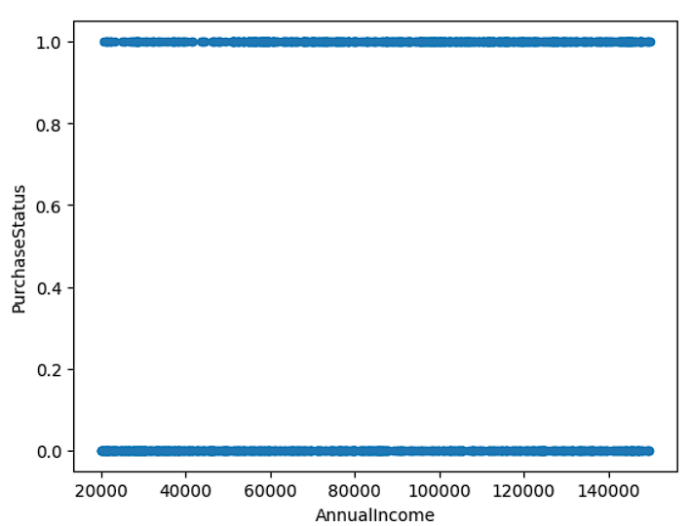
Data Visulization

Slide 6
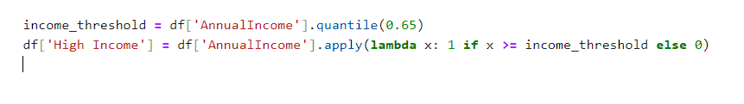
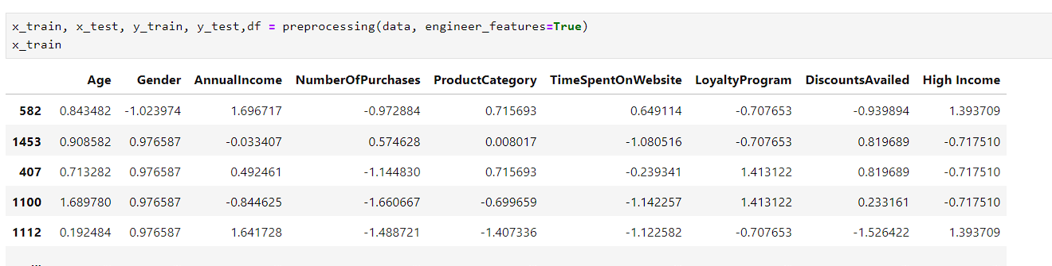
Step – 3: Feature Engineering and Split the data
Feature Engineering: I made a new column called “High Income” subtracted from Annual income whose quantile value is greater than 65% is considered 1 otherwise considered as 0.
A. standardize the dataset’s columns: Because all the columns have different units so I standardize the dataset’s columns
B.Split the train and test dataset :

Slide 7
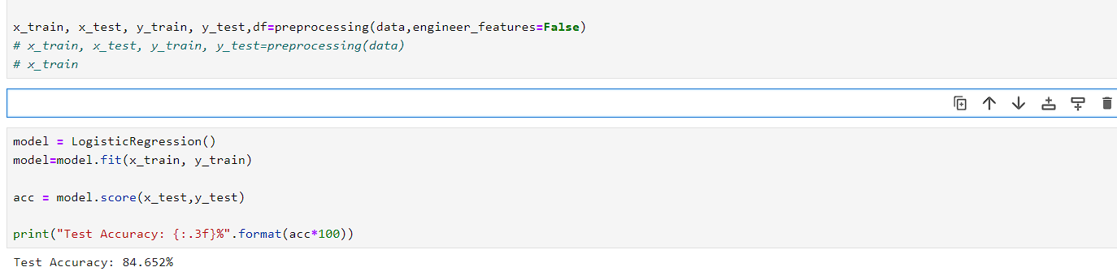
Step - 4 : Train and Test The data (Without feature engineering)

Slide 8
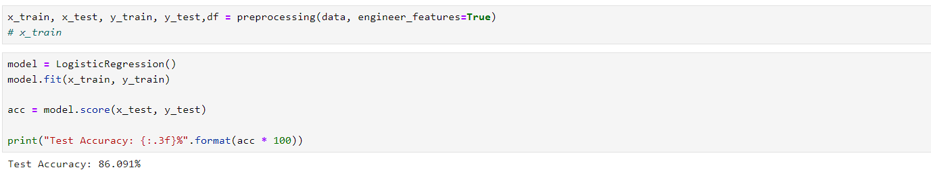
Train and Test The data (With feature engineering)

Slide 9
Thank you!

